Slide 1
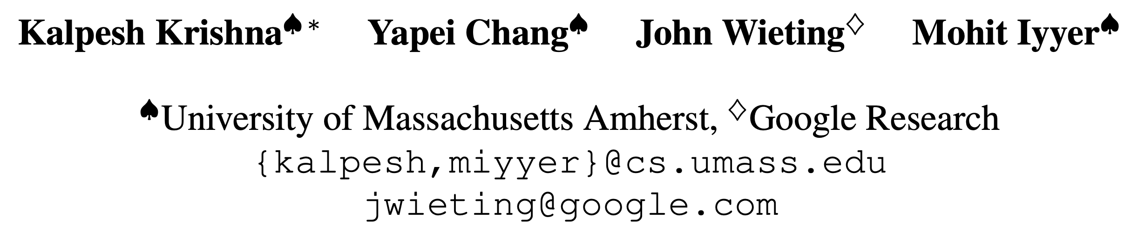
EMNLP 2022
RankGen:
Improving Text Generation with Large Ranking Model
Presenter: Jungwoo Lim

Slide 2
Introduction
Generation with Pre-trained Language Model
  Modern LMs suffer from the “likelihood trap” in which high likelihood sequences produced by greedy decoding or beam search tend to be dull and repetitive
  While truncated sampling methods such as top-k, nucleus, and typical sampling alleviate these issues, they can also produce text with inconsistencies, hallucinations, factual errors, or commonsense issues
  LMs are trained using “teacher forcing”, where they are always given the ground-truth prefix and asked to predict the next token
  At test-time, however, the prefix can contain model-generated text, allowing errors to propagate during decoding

Slide 3
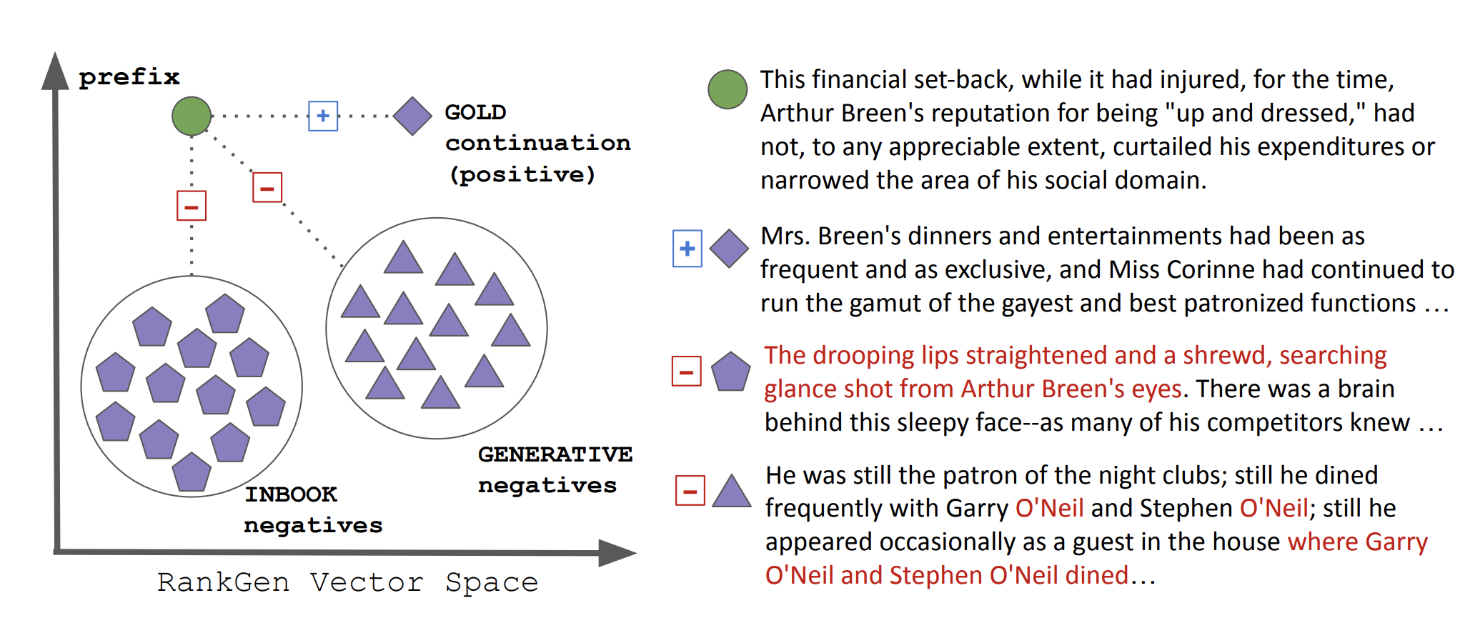
Introduction
RankGen
  INBOOK: select random sequences that occur within the same document as the prefix
  GENERATIVE: generate continuations by conditioning a large pretrained LM on a given prefix.
  1.2 billion parameter English encoder model that maps both human-written prefixes and model generated continuations of those prefixes (generations) to a shared vector space

Slide 4
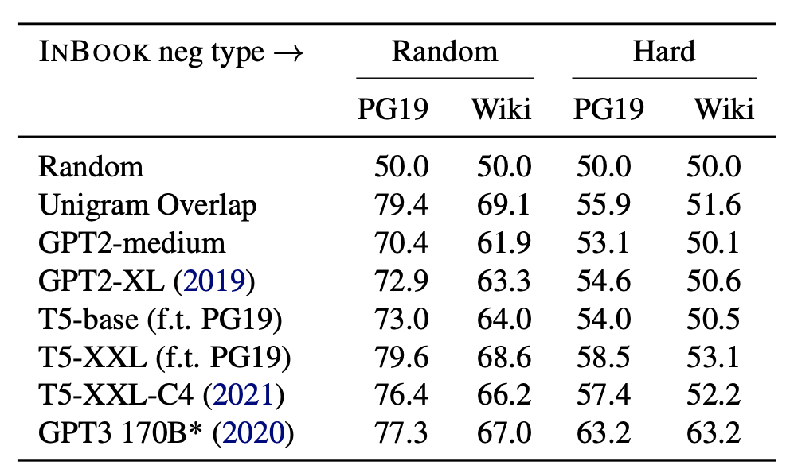
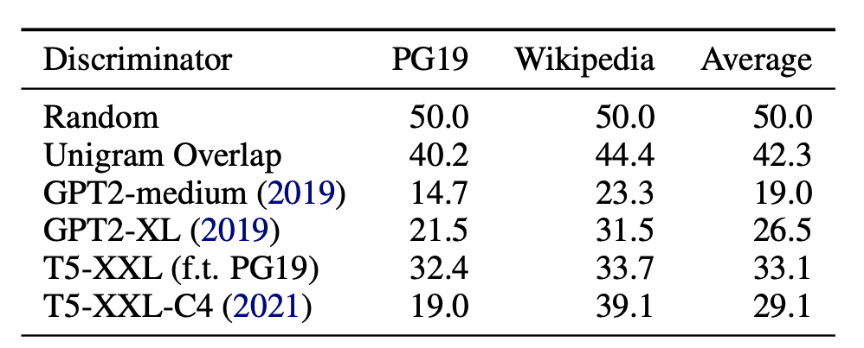
RANKGEN: a generation ranker
INBOOK Negatives
  LMs struggle to distinguish gold continuations from INBOOK negatives
GENERATIVE negatives
  negative samples are continuations to a prefix that are generated by a pretrained LM
  Machine-generated text is known to differ significantly from human text, containing repetitions, and hallucinations

Slide 5
RANKGEN: a generation ranker
Training RankGen
  Train RANKGEN using large-scale contrastive learning with in-batch negative sampling
  Use a contrastive objective that pushes the prefix vector pi close to the gold continuation vector c , but away from both the generation vector g as well as all other continuation vectors c in the same minibatch (“in-batch negative sampling”)

Slide 6
RANKGEN: a generation ranker
RankGen Inference
  After model training, the dot product between the prefix and continuation vectors denotes their compatibility score.
  We experiment with two strategies for using these scores during generation:
  (1) overgeneration and reranking, in which we use any pretrained LM and decoding algorithm to generate multiple samples (20 in our experiments) and then re-rank them;
  (2) beam search, in which we generate N samples of length L via nucleus or ancestral sampling, compute the top B highest-scoring samples via RANKGEN, and concatenate them to the prefix to continue generation

Slide 7
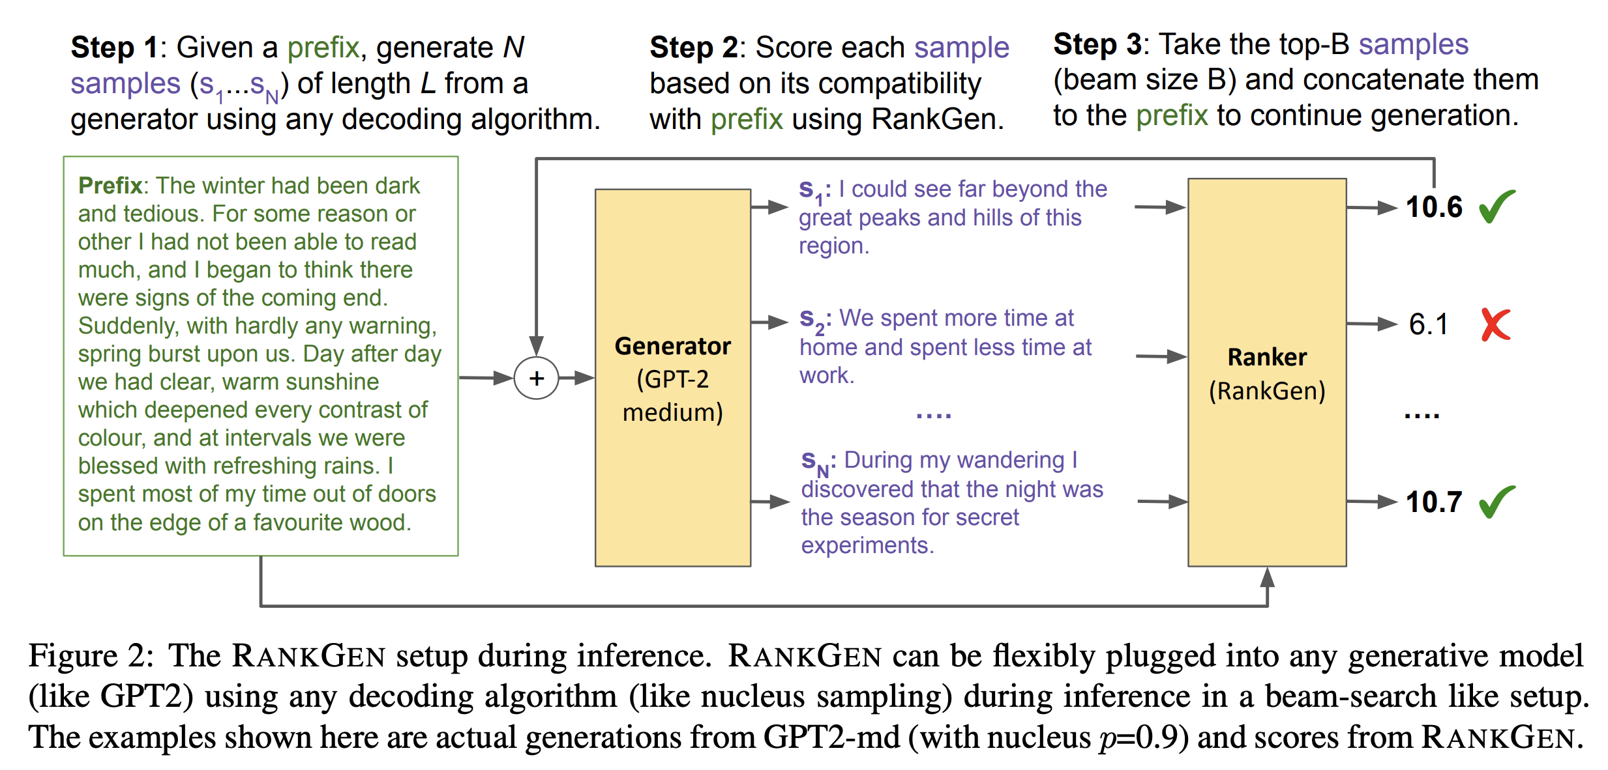
RANKGEN: a generation ranker
RankGen Inference
  After model training, the dot product between the prefix and continuation vectors denotes their compatibility score.

Slide 8
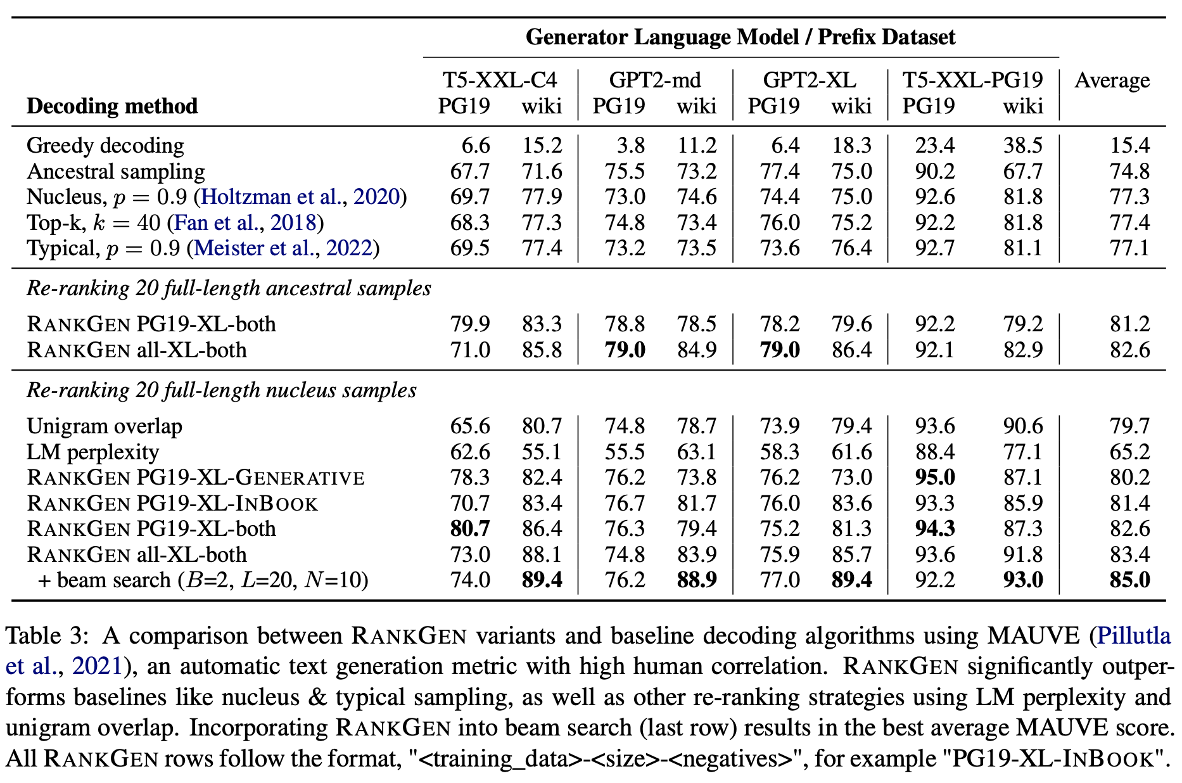
Experiments
Experiments
  RANKGEN re-ranking and beam search significantly improves MAUVE
  INBOOK negatives help more than GENERATIVE, but using both maximizes MAUVE

Slide 9
Limitations
Limitations
  While RANKGEN itself is efficient, generating multiple samples increases decoding time by an order of magnitude.
  RANKGEN is a re-ranking method, so it relies on other decoding methods to produce the candidate output set.
  Biases in the output candidate set from existing decoding algorithms maybe present in RANKGEN outputs.

Slide 10
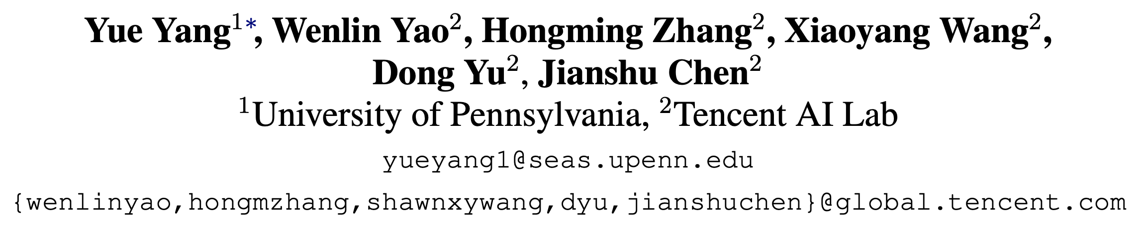
EMNLP 2022
Z-LaVI: Zero-Shot Language Solver
Fueled by Visual Imagination
Presenter: Jungwoo Lim

Slide 11
Introduction
Pre-trained Language Model & Zero-shot Learning
  Recent research suggests that NLP’s understanding ability improves by
  further scaling up the model size (e.g., to hundreds of billions of parameters) and the amount of textual pretraining data
  However, zero-shot language learners solely trained on texts inevitably suffer from human reporting bias. For example, 1) people tend not to write common or apparent things, and the 2) frequency of a certain textual statement does not always correspond to their relative likelihood in the world.
  Therefore, looking into other modalities to supplement the textual information is crucial

Slide 12
Introduction
Proposal
  Focus on incorporating vision knowledge to facilitate the solution of plain language understanding tasks
  Cognitive science has demonstrated that the human vision system is crucial to supplement, interact, and influence the language system
  For example, there exists a fast mapping between vision and language in the human language learning process.
  Inspired by this, they propose a visual imagination framework, Z-LaVI, to endow any PLMs (e.g., GPT, BERT, BART, etc.) with visual imagination capabilities.

Slide 13
Method
Language with Visual Imagination
  1) RECALL: We use the text input to query Bing Image Search to recall the corresponding images. We set a maximum number of images for each query. When only limited images are available for some queries, we download all of them.
  2) SYNTHESIS: We adopt DALL·E (Ramesh et al., 2021), a text-to-image generation model pretrained on image-caption pairs, to synthesize images. DALL·E constructs a codebook V using a discrete variational autoencoder (dVAE) (Rolfe, 2016) to map the image into tokens concatenated with the caption’s text tokens. DALL·E models the joint distribution over the text and image tokens with an autoregressive transformer..

Slide 14
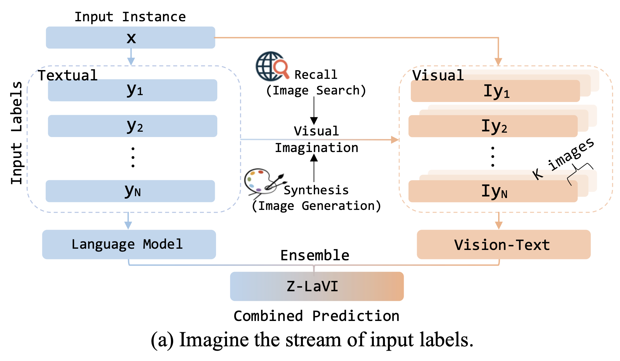
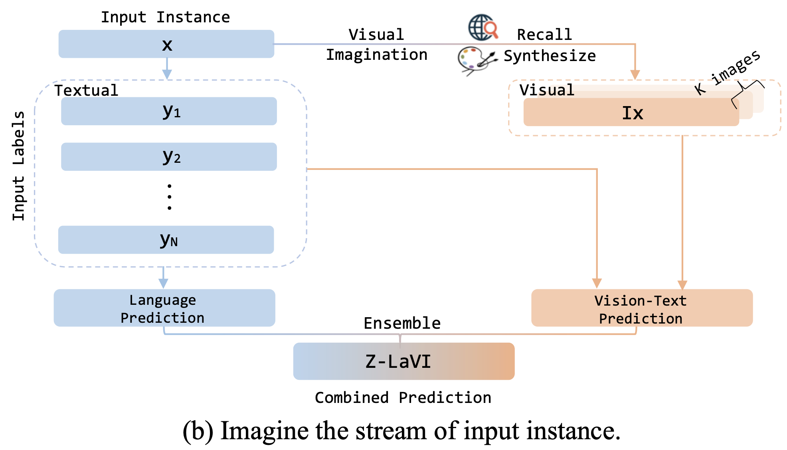
Method
Language with Visual Imagination

Slide 15
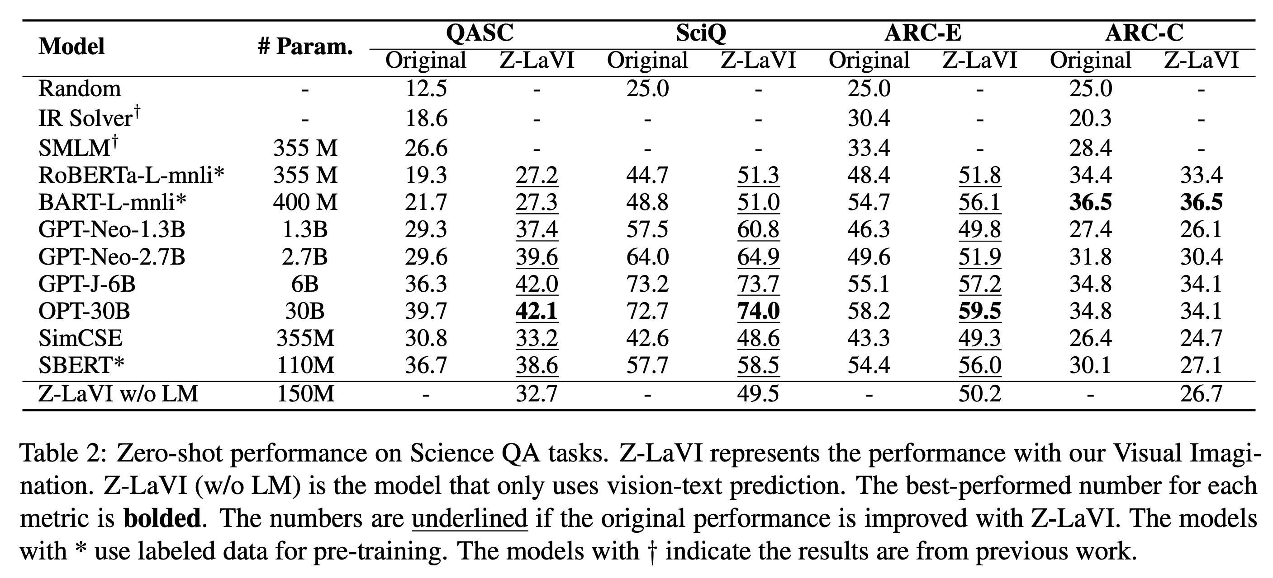
Experiments
Experiments

Slide 16
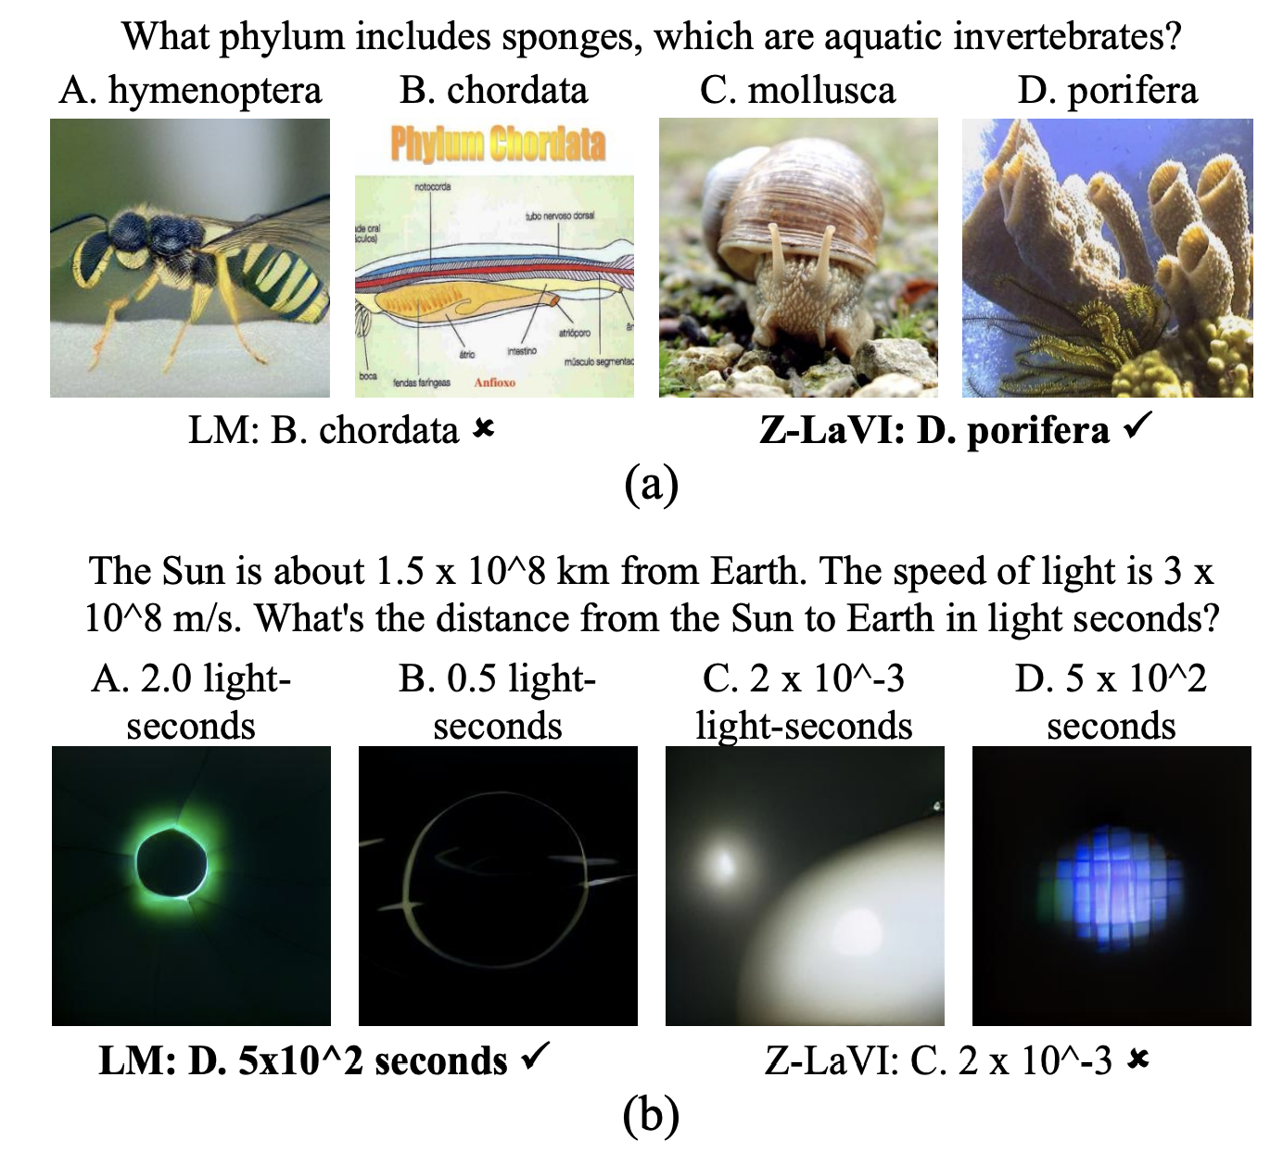
Experiments
Qualitative Analysis

Slide 17
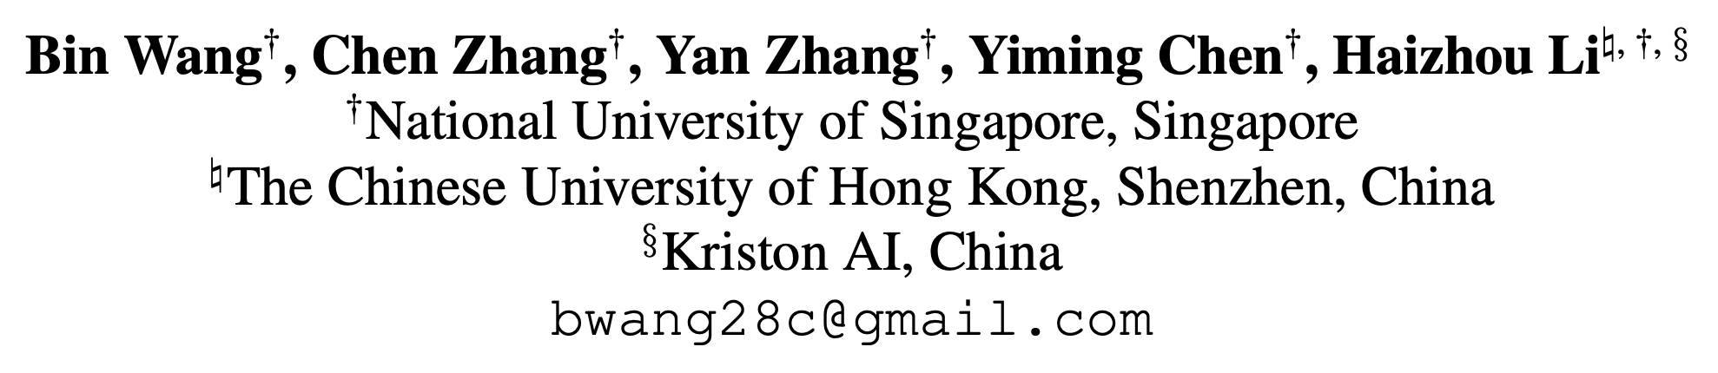
EMNLP 2022
Analyzing and Evaluating Faithfulness
in Dialogue Summarization
Presenter: Jungwoo Lim

Slide 18
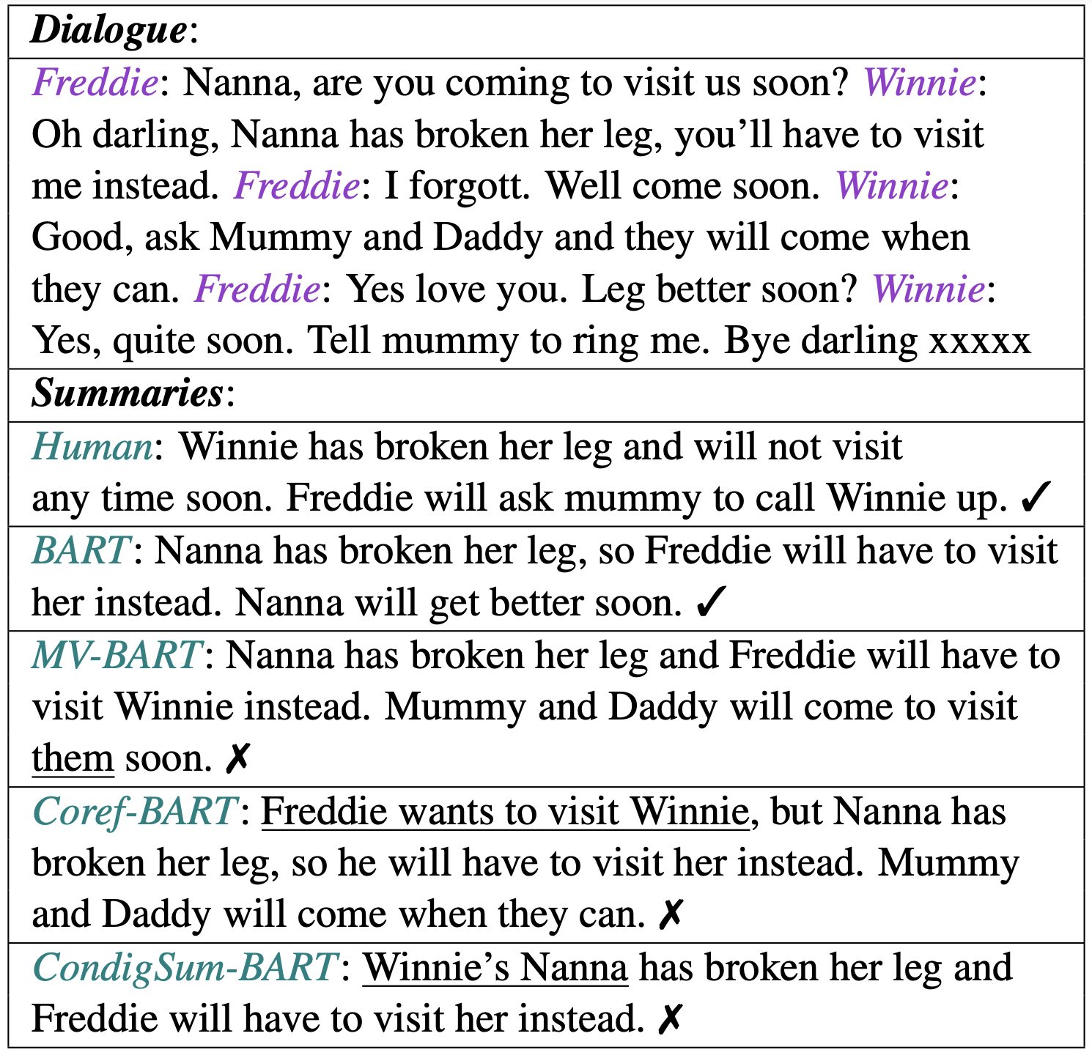
Introduction
Previous Works
  Discovered that abstractive summarization suffers from unfaithful outputs, limiting its applicability in realworld scenarios
  As an essential way of exchanging information, conversations usually involve multiple participants, informal language usage, repetition, and negations. Therefore, dialogue summarization is vulnerable to factual issues due to its abstractive nature.

Slide 19
Introduction
Proposal
  Categorize the most frequently occurred factual errors for dialogue summarization into 6 types.
  Collect finegrained factual annotations for human reference and the output of 4 recent dialogue summarization systems
  Present a model-level evaluation schema, FacEval, targeting dialogue summarisation models’ faithfulness

Slide 20
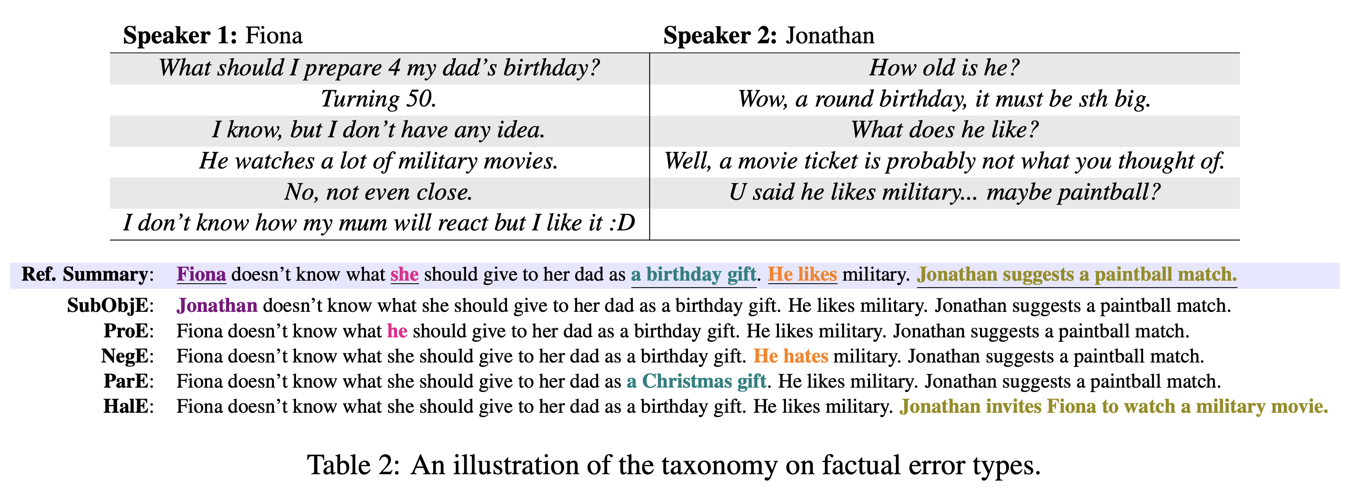
Analysis
Fine-grained Faithfulness Analysis

Slide 21
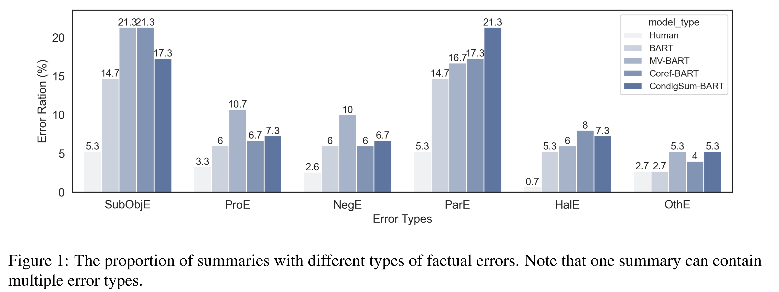
Analysis
Fine-grained Faithfulness Analysis

Slide 22
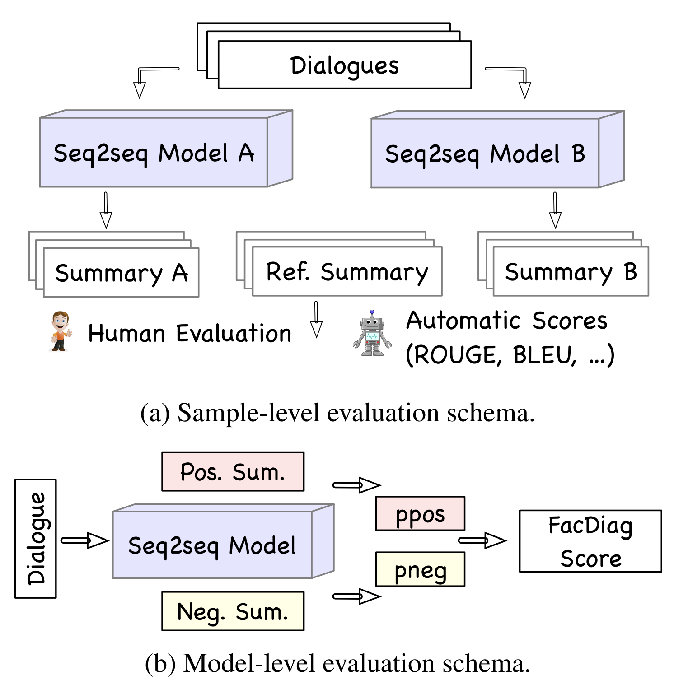
Model-level Faithfulness Evaluation
Evaluation
  Propose directly probing models’ generation probability with a constrained search space.
  First, FacEval generates a set of positive and negative samples with variant factual errors by rule-based transformations.
  Then, the generation probabilities of positive and negative summaries are compared for each dialogue.
  A better summarization model should be more likely to generate positive summaries than negative ones.

Slide 23
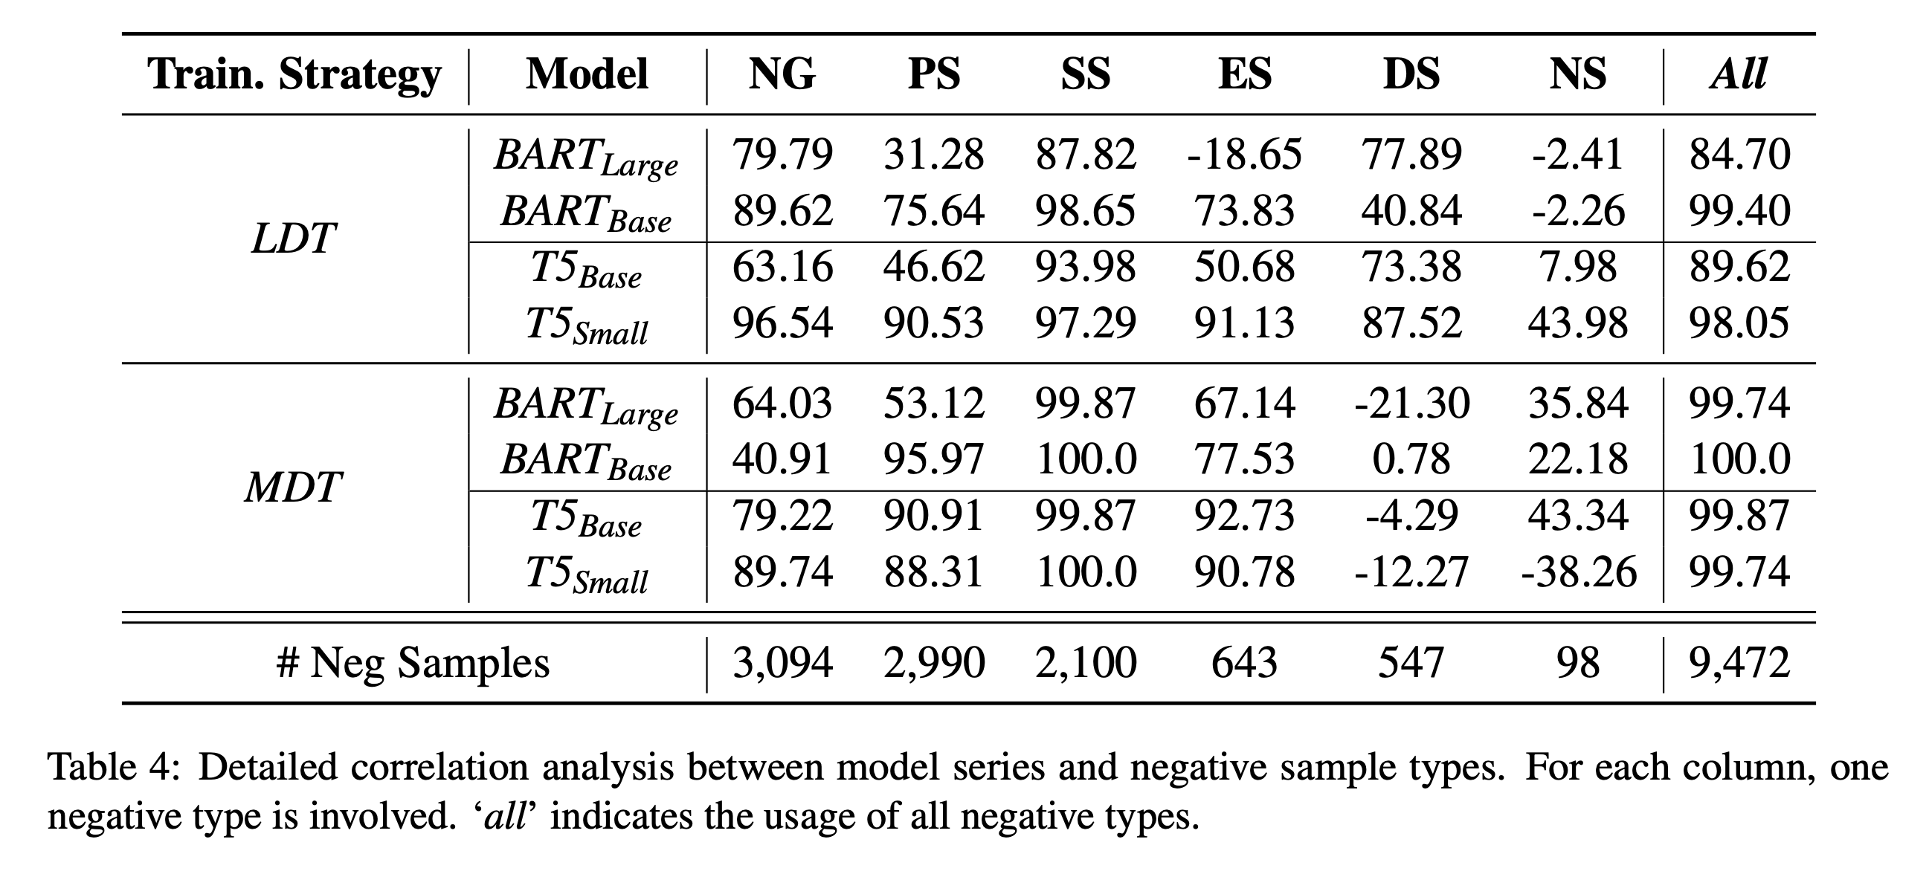
Experiments
Experiments

Slide 24
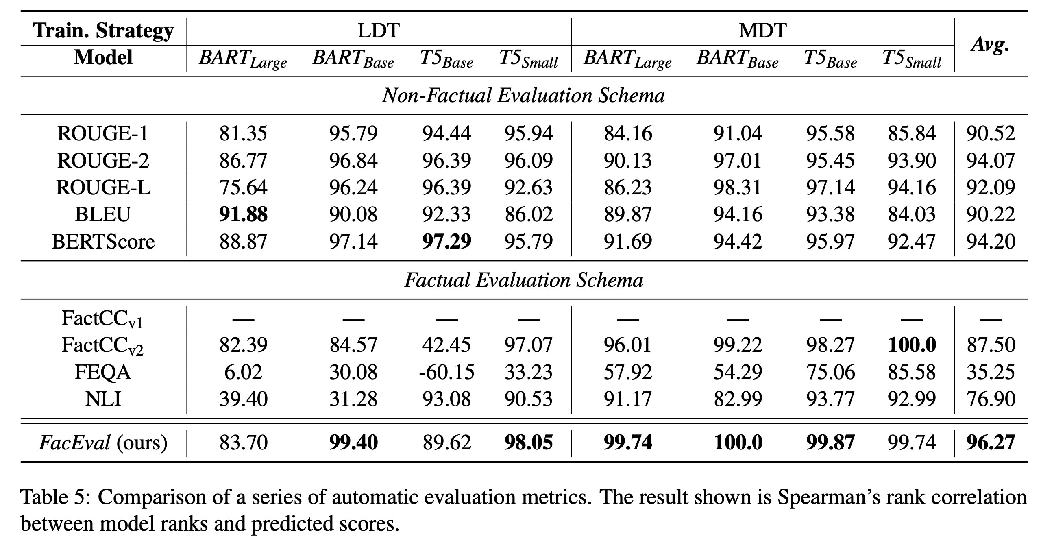
Experiments
Experiments

Slide 25
Thank you

